Slide 1
Green Skilling and Sustainability
NAME :- Jain Divyani Abhay
Enrollment No. :- 230760107044
Stream :- Computer Engineering
College :- Shree Swami Atmanand Saraswati
Institute of Technology (SSASIT)

Slide 2
What is SDG 17 – Partnerships for the Goals ?
SDG 17 Goals is the 17 Sustainable Development Goal established by the United Nations. Its main objective is to strengthen global partnerships so that all 17 SDGs can be achieved. It means that governments, businesses, schools, NGOs, and people from different countries work together by sharing knowledge, technology, resources and finance to solve global problems such as poverty, climate change, health, and education.
What is Green Skilling ?
Green Skilling is the process of developing knowledge and skills that help to protect the environment and promote sustainable development. It prepares people for eco-Friendly jobs and encourages the efficient use of natural resources. It includes learning practices such as renewable energy, waste management, water conservation, and organic farming. It helps reduce pollution and supports a greener economy. By developing green skills, individuals can contribute to a cleaner, healthier, and more sustainable future.

Slide 3
What is Sustainability ?
Sustainability means using natural resources wisely so that they are available for future generations while meeting the needs of the present. It focuses on protecting the environment, supporting economic growth, and improving social well-being. Sustainable practices help reduce pollution, conserve resources, and maintain ecological balance. It encourages responsible use of energy, water, and other resources. Sustainability ensures a healthy planet and a better quality of life for both present and future generations.
Is AI Good or Bad for Sustainability ?
AI can support sustainability by improving energy efficiency, reducing waste, and helping monitor climate change. It is used in smart farming, renewable energy management, and pollution control.
However, AI systems also require large amounts of electricity and powerful computers, which can increase carbon emissions if powered by fossil fuels. Therefore, AI should be developed and used responsibly . When used wisely, AI can play an important role in achieving sustainability goals.

Slide 4
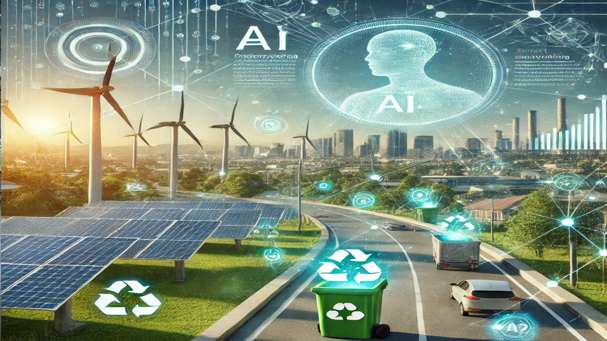
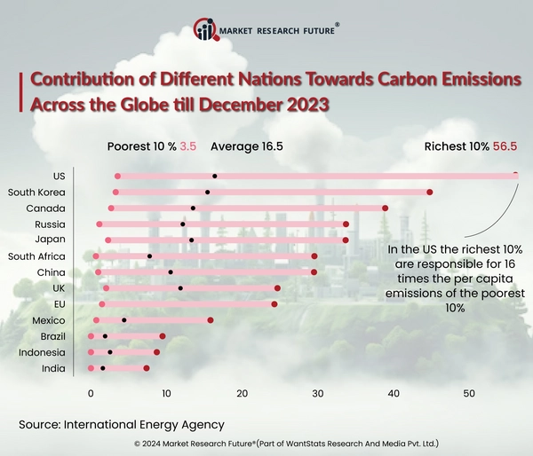
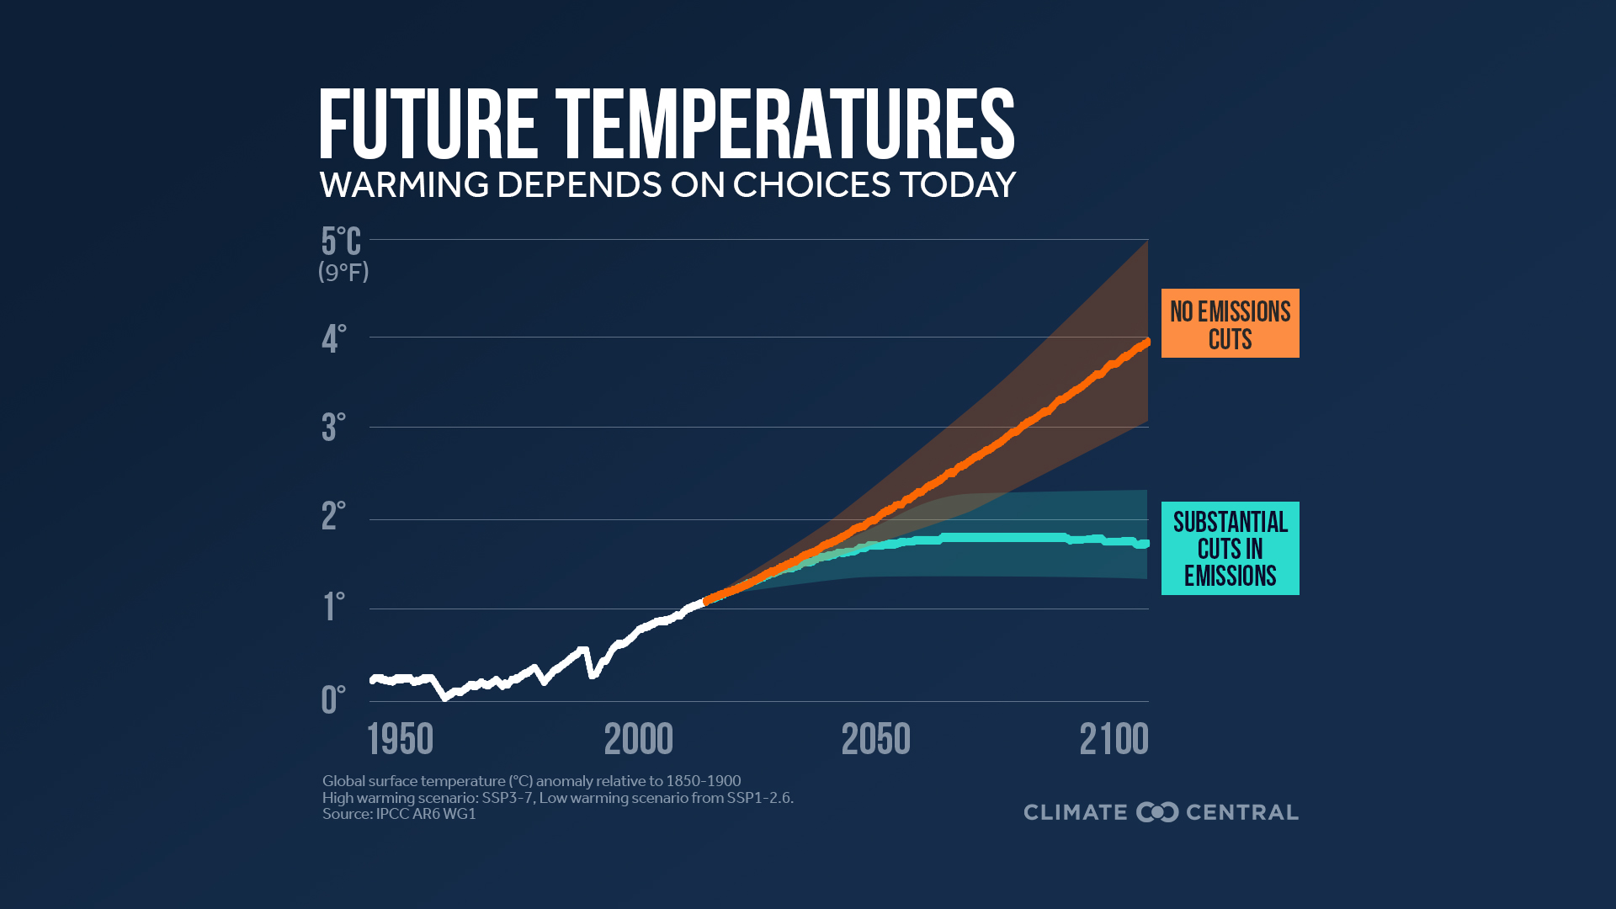


Slide 5
Capstone Project :- AI Garbage Detection from images A user uploads a photo of street, park, beach, or place where garbage is thrown.
What AI does :
Analyzes the uploaded image.
Identifies the different types of waste.
Helps in waste segregation and recycling.
Estimates how much waste is present.
Generates a cleanliness score.

